Slide 1
Concept of health and disease

Slide 2
Concept of health
1. Biomedical Concept
2. Ecological Concept
3. Psychosocial Concept
4. Holistic Concept

Slide 3
DEFINITION OF HEALTH
The widely accepted definition of health is that given by the World Health Organization (1948) in the preamble to its constitution, which is as follows:
“Health is a state of complete physical, mental and social well-being and not merely an absence of disease or infirmity”.

Slide 4
Biomedical concept
This concept has the basis in the “germ theory of disease” which dominated medical thought at the turn of the disease. The criticism that is levelled against the biomedical concept is that it has minimized the role of the environmental, social, psychological and cultural determinants of health. The biomedical model was found inadequate to solve some of the major problems of mankind such as: Malnutrition Chronic diseases Accidents Drug abuse Mental illness Environmental pollution Population explosion

Slide 5
Ecological concept
This concept views health as a dynamic equilibrium between man and his environment,and disease a maladjustment of the human organism to environment. Human, ecological and cultural adaptations do determine not only the occurrence of disease but also the availability of food and the population explosion. The ecological concept raises two issues: ☆ imperfect man ☆ imperfect environment

Slide 6
Psychosocial concept
Contemporary developments in social sciences revealed that health is not only a biomedical phenomenon, but one which is influenced by social, psychological, cultural, economic and political factors of the people concerned.

Slide 7
Holistic Concept
This concept is a synthesis of all the above concepts. It recognizes the strength of social, economic, political and environmental influences on health. The holistic approach implies that all sectors of society have an effect on health like: Agriculture Animal husbandry Food Industry Education Housing Public works Communications and other sectors. The emphasis is on the promotion and protection of health.

Slide 8
New philosophy of health
Health is a fundamental human right.
Health is the essence of productive life, and not the result of e er increasing expenditure on medical care.
Health is intersectoral.
Health is an integral part of development.
Health is central to the concept of quality of life.
Health involves individuals, state and international responsibility.
Health and its maintenance is a major social investment.
Health is a worldwide social goal.

Slide 9
Dimensions of health
Physical dimension
Mental dimension
Social dimension
Spiritual dimension
Emotional dimension
Vocational dimension

Slide 10
Others:
Philosophical dimension
Cultural dimension
Socio-economic dimension
Environmental dimension
Educational dimension
Nutritional dimension
Curative dimension
Preventive dimension

Slide 11
PHYSICAL DIMENSION
The state of physical health implies the notion of “perfect functioning” of the body.
It conceptualizes health biologically as a state in which every cell and every organ is functioning at optimum capacity and in perfect harmony with the rest of the body.

Slide 12
Evaluation of physical health
Self assessment of overall health.
Inquiry into symptoms of ill-health and risk factors.
Inquiry into medications.
Inquiry into levels of activity.
Inquiry into use of medical services.
Standardized questionnaires for cardiovascular diseases.
Standardized questionnaires for respiratory diseases.
Clinical examination.
Nutrition and dietary assessment.
Biochemical and laboratory investigations.

Slide 13
Mental dimension
Mental health has been defined as
“A state of balance between the individual and the surrounding world, a state of harmony between oneself and others, a coexistence between the realities of the self and that of other people and that of the environment”.
Good mental health is the ability to respond to the many varied experiences of life with flexibility and a sense of purpose.

Slide 14
Psychologists have mentioned the following characteristics as attributes of a mentally healthy person:
A mentally healthy person is free from internal conflicts.
He is well adjusted.He accepts criticism and is not easily upset.
He searches for identity.He has a strong sense of self esteem.
He knows himself, his needs, problems and goals.
He has good self-control-balances rationality and emotionality.
He faces problems and tries to solve them intelligently, that is, coping with stress and anxiety.

Slide 15
Social dimensions
It has been defined as the quantity and quality of an individual’s interpersonal ties and the extent of involvement with the community.
The social dimension of health includes:
The levels of social skills one possesses.
Social functioning.
The ability to see oneself as a member of a larger society.
Social health is rooted in “positive material environment” and “positive human environment” which is concerned with the social network of the individual.

Slide 16
Spiritual dimension
Spiritual health in this context, refers to that part of the individual which reaches out and strives for meaning and purpose in life.
It includes integrity, principles and ethics, the purpose in life, commitment to some higher being and belief in concepts that are not subject to “state of the art” explanation.

Slide 17
Emotional dimension
The mental and emotional dimensions have been seen as one element or as two closely related elements.
Mental health can be seen as “knowing” or “cognition”, while emotional health relates to “feeling”.

Slide 18
Positive health
The state of positive health implies the notion of “perfect functioning” of the body and mind. It conceptualizes health,
Biologically- as a state in which every cell and every organ is functioning at optimum capacity and in perfect harmony with rest of the body.
Psychologically- as a state in which the individual feels a sense of perfect well-being and of mastery over his environment.
Socially- as a state in which the individual’s capacities for participation in the social system are optimal.
The concept of perfect positive health cannot become a reality because man will never be so perfectly adapted to his environment that his life will not involve struggles, failures and sufferings.

Slide 19
Concept of well-being
Standard of living- income and occupation, standards of housing, sanitation and nutrition, the level of provision of health, educational, recreational and other services may all be used individually as measures of socio-economic status, and collectively as an index of “standard of living”.
Level of living- It consists of nine components:
Health
Food consumption
Education
Occupation

Slide 20
Housing
Social security
Clothing
Recreation and liesure
Human rights
3. Quality of life- The condition of life resulting from the combination of the effects of the complete range of factors such as those determining health, happiness, education, social and intellectual attainments, freedom of action, justice and freedom of expression.

Slide 21
Physical quality of life index (pqli)
It consolidates three indicators:
Infant Mortality
Life expectancy at age one
Literacy
These three components measure the results rather than inputs.
For each component the performance of individual countries is placed on a scale of 0 to 100,
where 0 represents an absolutely defined “worst” performance, and 100 represents an absolutely defined “best” performance.
The composite index is calculated by averaging the three indicators, giving equal weight to each of them.
The resulting PQLI thus also is scaled 0 to 100.

Slide 22
Human development index (hdi)
It is defined as “a composite index focusing on three basic dimensions of human development:
☆ To lead a long and healthy life measured by life expectancy at birth;
☆ The ability to acquire knowledge, measured by mean years of schooling and expected years of schooling;
☆ The ability to achieve a decent standard of living, measured by gross national income per capita in PPP US $.
The concept of HDI reflects achievements in a most basic human capabilities, viz,
☆ Leading a long life
☆ Being knowledgeable
☆ Enjoying a decent standard of living.
The HDI values range between 0 to 1. The HDI value for a country shows the distance that it has already traveled towards maximum possible value to 1, and also allows comparison with other countries.

Slide 23
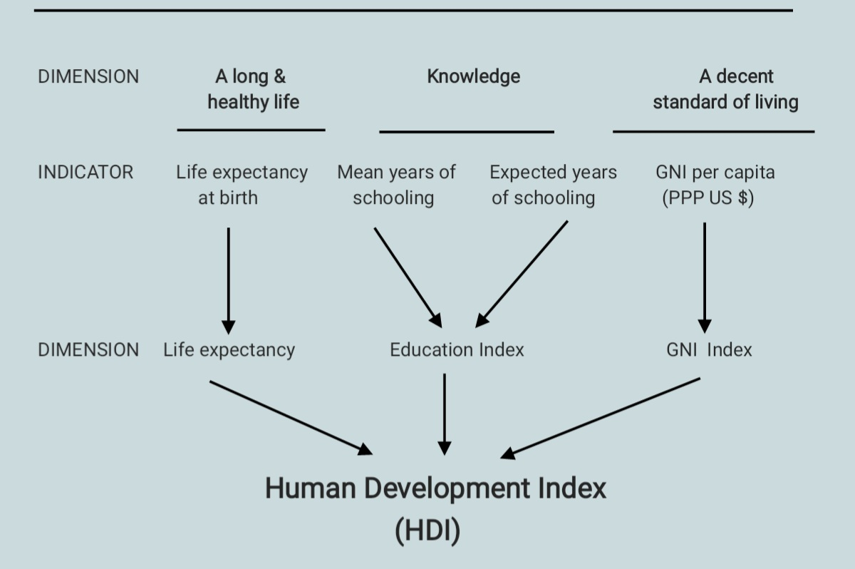
Calculating the Human Development Index (HDI)

Slide 24
SPECTRUM OF HEALTH
Health and disease lie along a continuum, and there is no single cut-off point.
The lowest point on the health-disease spectrum is death and the highest point corresponds to the WHO definition of positive health.
The spectral concept of health emphasizes that the health of an individual is not static; it is a dynamic phenomenon and a process of continuous change, subject to frequent subtle variations.

Slide 25
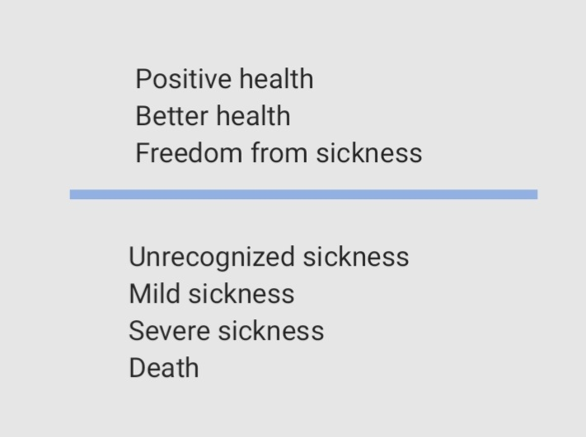
The health sickness spectrum

Slide 26
DETERMINANTS OF HEALTH
Biological Determinants
Behavioural and socio-cultural conditions
Environment
Socio-economic conditions
Aging of the population
Gender
Other factors

Slide 27
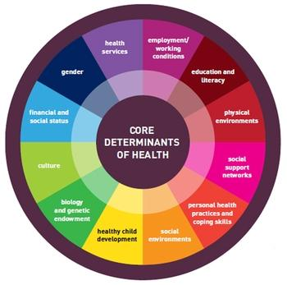
Determinants of health

Slide 28
To be continued in next class
To be continued in next class…….

Slide 29


